Slide 1
Understanding Virtualization
Module-2

Slide 2
VIRTUALIZATION & INFRASTRUCTURE AS A SERVICE
Matthew Portnoy “Virtualization Essentials “ John Wiley and Sons Publication. (Text Book 2: Chapter 1 to 3)
Understanding Virtualization, Understanding Hypervisors, Understanding Virtual Machines

Slide 3
VIRTUALIZATION & INFRASTRUCTURE AS A SERVICE
Rajkumar Buyya, James Broberg, Andrzej Goscinski “Cloud Computing Principles and Paradigms” Wiley Publications , 2013
(Text Book 1: Chapter 5: 5.1 to 5.6)
Understanding Virtualization: Describing virtualization, Virtual Machines Provisioning and Migration Services: Introduction and Inspiration, Background and Related Work, Virtual Machines Provisioning and Manageability, Virtual Machine Migration Services, VM Provisioning and Migration in Action, Provisioning in the Cloud Context
Notes:
VM provisioning means the automated process of creating, configuring, and deploying a virtual machine (VM) with necessary resources (CPU, RAM, storage, network) and software (OS, applications) on a physical server or cloud platform, making it ready to use, often via self-service portals or scripts, rather than manual setup. It's the initial step in a VM's lifecycle, transforming abstract resources into a functional, customized server instance.

Slide 4
Virtualization
Virtualization in computing often refers to the abstraction of some physical component into a logical object(Virtual Machine).
Over last 60 years key trends created the fundamental changes in how computing services are provided
Notes:
A host virtual machine is the server component of a virtual machine (VM), the underlying hardware that provides computing resources to support a particular guest virtual machine (guest VM). The host virtual machine and the guest virtual machine are the two components that make up a virtual machine. The guest VM is an independent instance of an operating system and associated software and information. The host VM is the hardware that provides it with computing resources such as processing power, memory, disk and network I/O (input/output), and so on.
A virtual machine monitor (VMM) or hypervisor intermediates between the host and guest VM, isolating individual guest VMs from one another and making it possible for a host to support multiple guests running different operating systems.

Slide 5
Describing virtualization
Sixties and seventies - Mainframe processing.
Eighties and nineties - Personal computers, the digitization and client/ server technology.
last and current centuries and continues today - The Internet.
Now we are in the midst of another of those model- changing trends: virtualization

Slide 6
Examples:
A virtual local area network (VLAN) is a logical group of workstations, servers and network devices that appear to be on the same LAN despite their geographical distribution.
Similary, Virtual Storage Area Networks (VSANs) software storage technology that provides logical storage networks within a physical store network.
Notes:
A Virtual Local Area Network (VLAN) is a logical grouping of devices that are connected in a network. VLAN improves the security, performance, management, and configuration of the network. VLAN is used in VoIP networks for prioritizing voice traffic and segregating them from data traffic.
A Virtual Storage Area Network (VSAN) is defined as a software storage technology that provides logical storage networks within a physical store network. VSAN is used for database applications such as SQL, and Oracle to provide reliable storage.

Slide 7
Benefits of VLAN
Improved Security: VLANs provide network security by logically separating the incoming and outgoing network traffic.
Network Performance: VLANs improve the network performance by optimizing the network traffic, and controlling the flow of data accordingly.
Scalability: VLANs can make it easy to scale their network and accordingly add new users, devices, and applications without any more physical configurations.
Simplified Network Management: VLANs can simplify the management of networks by grouping the devices and users logically and as a result making it easy for network management.

Slide 8
Benefits of VSAN
Scalability: According to the need more devices can be connected within the network, therefore VSAN provides the benefit of scalability.
Reduced Costs: VSAN reduces the costs for hardware that are required for external data storage.
Data Security: VSAN provides data security from data loss due to hardware or software failure.

Slide 9
Our focus is on virtualizing the entire Computer
Virtual machine (VM) can virtualize all of the hardware resources, including processors, memory, storage, and network connectivity.
A virtual machine monitor (VMM), which today is commonly called a hypervisor is a software that provides the environment in which the VM operates.
Notes:
A hypervisor, also known as a virtual machine monitor or VMM, is software that creates and runs virtual machines (VMs). A hypervisor allows one host computer to support multiple guest VMs by virtually sharing its resources, such as memory and processing.
A VM is a virtualized instance of a computer that can perform almost all of the same functions as a computer, including running applications and operating systems. Virtual machines run on a physical machine and access computing resources from software called a hypervisor.

Slide 10
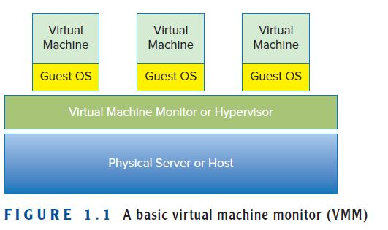
Virtualization
Figure 1.1 shows a simple illustration of a VMM.
Notes:
A host virtual machine is the server component of a virtual machine (VM), the underlying hardware that provides computing resources to support a particular guest virtual machine (guest VM). The host virtual machine and the guest virtual machine are the two components that make up a virtual machine. The guest VM is an independent instance of an operating system and associated software and information. The host VM is the hardware that provides it with computing resources such as processing power, memory, disk and network I/O (input/output), and so on.
A virtual machine monitor (VMM) or hypervisor intermediates between the host and guest VM, isolating individual guest VMs from one another and making it possible for a host to support multiple guests running different operating systems.

Slide 11
VMM needs to exhibit three properties in order to correctly satisfy their definition:
Fidelity
Isolation or Safety
Performance.
Notes:
Fidelity The environment it creates for the VM is essentially identical to the
original (hardware) physical machine.
Isolation or Safety The VMM must have complete control of the system
resources.
Performance There should be little or no difference in performance between
the VM and a physical equivalent.

Slide 12
Virtualization
Virtualization is the ability to run multiple operating systems on a single physical system and share the underlying hardware resources.
The machine on which the virtual machine is created is known as a host machine and the virtual machine is referred to as a guest machine.
This virtual machine is managed by software or firmware, which is known as hypervisor.
Notes:
A host virtual machine is the server component of a virtual machine (VM), the underlying hardware that provides computing resources to support a particular guest virtual machine (guest VM). The host virtual machine and the guest virtual machine are the two components that make up a virtual machine. The guest VM is an independent instance of an operating system and associated software and information. The host VM is the hardware that provides it with computing resources such as processing power, memory, disk and network I/O (input/output), and so on.
A virtual machine monitor (VMM) or hypervisor intermediates between the host and guest VM, isolating individual guest VMs from one another and making it possible for a host to support multiple guests running different operating systems.

Slide 13
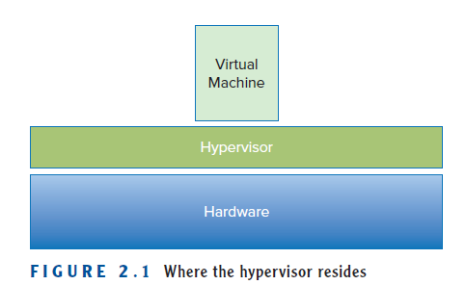
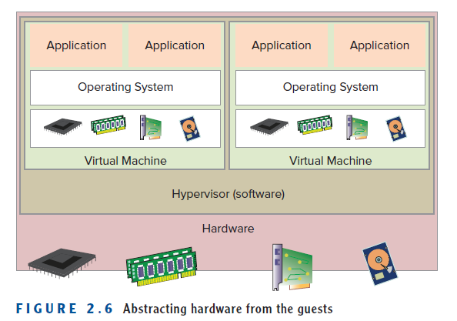

Slide 14
Fundamental idea – abstract hardware of a single computer into several different execution environments
  Similar to layered approach
  Layer creates virtual system (virtual machine (VM)) on which applications can run
Several components
  Host – underlying hardware system
  Virtual machine monitor / manager(VMM) or hypervisor – creates and runs virtual machines by providing interface that is identical to the host
  Guest – Virtual machine
Single physical machine can run multiple operating systems concurrently, each in its own virtual machine

Slide 15
Virtual machine (VM) can virtualize all of the hardware resources, including processors, memory, storage, and network connectivity. A virtual machine monitor (VMM), which today is commonly called a hypervisor is the software that provides the environment in which the VMs operate.

Slide 16
A hypervisor, also called as a virtual machine manager/monitor (VMM), or virtualization manager, is a program that allows multiple operating systems to share a single hardware host.
Each guest operating system appears to have the host's processor, memory, and other resources all to itself.
Hypervisor controls the host processor and resources, by allocating what is needed to each operating system in turn and making sure that the guest operating systems (called virtual machines) cannot disrupt each other.

Slide 17
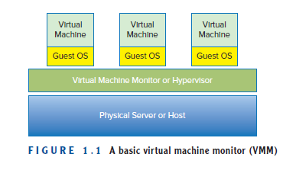
Basic VMM

Slide 18
According to Popek and Goldberg,
(Who described the requirements for a computer system to support virtualization)
VMM needs to exhibit three properties in order to correctly satisfy their definition:
Fidelity (reliability) The environment it creates for the VM is essentially identical to the original (hardware) physical machine.
Isolation or Safety The VMM must have complete control of the system resources.
Performance There should be little or no difference in performance between the VM and a physical equivalent.

Slide 19
MS Windows was developed during 1980s primarily as Personal Computer OS
Companies moved from paper to run their accounting, human resources, and many other industry-specific applications on mainframes or minicomputers.
These computers usually ran vendor-specific operating systems, making it difficult, if not impossible, for companies and IT professionals to easily transfer information among non- compatible systems.
This led to the need for standards, agreed upon methods for exchanging information. So operating systems and programs should be able to run on many different vendors’ hardware. For example UNIX OS

Slide 20
Windows was originally designed to be a single-user operating system, a single application on a single Windows server ran fine, but often when a second program was introduced, the requirements of each program caused various types of resource contention (conflicts) and even out and out operating system failures.
This behavior drove many companies, application designers, developers, IT professionals, and vendors to adopt a “one server, one application” best practice. so for every application that was deployed, one or more servers needed to be acquired, provisioned, and managed.

Slide 21
As companies depended more and more on technology to drive their business, they added many more servers to support that need. Eventually, this expansion created data centers.
A data center could be anything from a larger computer room, to an entire floor in a building which existed solely to support many servers.

Slide 22
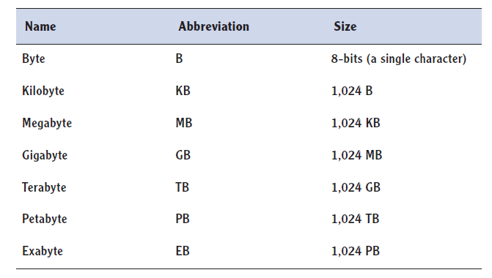
Innovative companies, such as Amazon and Google, creating disruptive business models that depended on large farms of servers to rapidly deliver millions of web pages populated with petabytes of information.
Building large data center is also very expensive, its maintenance etc
Notes:
A lost server is a server that is running, but no one actually knows which line of business owns it or what it is doing

Slide 23
Explaining Moore’s Law
Data centers started to grow massively ,In 2006 , one study estimated that the 16 million servers in use in 2000 had grown to almost 30 million by 2005.
A computer that you bought in 2000 has probably been supplanted by one you purchased in the last three to five years, and if it is closer to five years, you are probably thinking about replacing that one as well.
For example, digital cameras first captured images at less than one megapixel resolution and now routinely provide more than 12 megapixel resolutions. PCs, and now smart phones, initially offered memory (RAM) measured in kilobytes; today the standard is gigabytes, an increase of two orders of magnitude.
Notes:
Moore's law is the observation that the number of transistors in an integrated circuit (IC) doubles about every two years. Moore's law is an observation and ...
‎Moore's second law. The principle that the speed and capability of computers can be expected to double every two years,

Slide 24
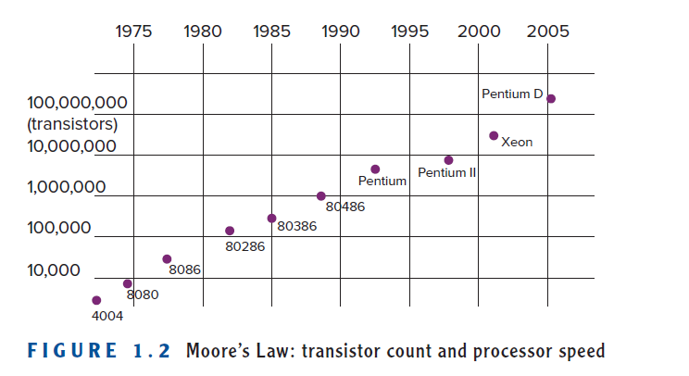
Notes:
Moore's law is the observation that the number of transistors in an integrated circuit (IC) doubles about every two years. Moore's law is an observation and ...
‎Moore's second law. The principle that the speed and capability of computers can be expected to double every two years,

Slide 25
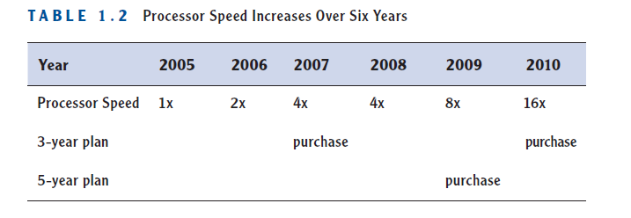
It is called Moore’s Law, and it deals with the rate at which certain technologies improve.
Moore’s Law applies not just to processing power (the speed and capacity of computer chips) but to many other related technologies as well (such as memory capacity and the megapixel count in digital cameras).

Slide 26


Slide 27
Understanding the Importance of Virtualization
There was a wild explosion of data centers overfilled with servers; but as time passed, in a combination of the effect of Moore’s Law and the “one server, one application” model, those servers did less and less work.
Popek and Goldberg’s definition, virtualization allows many operating systems to run on the same server hardware at the same time, while keeping each virtual machine functionally isolated from all the others. The first commercially available solution to provide virtualization for x86 computers came from VMware in 2001.

Slide 28
Benefits of Virtualization:
Sharing of resources helps cost reduction
Isolation: Virtual machines are isolated from each other as if they are physically separated
Encapsulation: Virtual machines encapsulate a complete computing environment
Hardware Independence: Virtual machines run independently of underlying hardware
Portability: Virtual machines can be migrated between different hosts.

Slide 29
What is consolidation in Virtualization?
With virtualization , overfull data centers and underutilized servers condensed multiple physical servers into one server that would run many virtual machines, allowing that physical server to run at a much higher rate of utilization.
This condensing of servers is called consolidation. A measure of consolidation is called the consolidation ratio and is calculated by counting the number of VMs on a server—for example, a server that has eight VMs running on it has a consolidation ratio of 8:1.

Slide 30
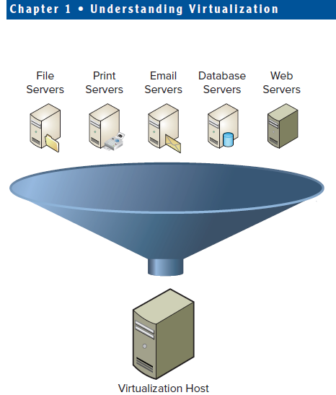
F I G U R E 1 . 3 Server consolidation

Slide 31
How does Consolidation drive down the cost?
Many studies show that the total cost of ownership for an individual servers somewhere between 3 and 10 times the cost of the server itself over three years.
In other words, if a server costs $5,000, the cost of maintaining that server is at least another $5,000 per year. Over three years, that is $20,000 per server (the initial hardware spend plus three years of maintenance costs).
Those ownership costs include software, annual software and hardware maintenance, power, cooling, cables, people costs, and more
So in this example, for every hundred servers the company can consolidate, it can save two million dollars the first year and every year afterward.
Notes:
20000X100=20 lakh=2 million

Slide 32
As companies began to see the benefits of virtualization,
they no longer purchased new hardware when their leases were over, when their hardware maintenance licenses expired.
Instead, they virtualized those server workloads. This is called containment.
Containment gives administrators a general-purpose undo capability. Administrators can suspend a virtual machine and resume it at any time, or checkpoint a virtual machine and roll it back to a previous execution state.
Containment benefited corporations in
→ no longer had to refresh large amounts of hardware year after year → costs of managing and maintaining those servers— power, cooling, etc.—were removed

Slide 33
In larger data centers, where hundreds or even thousands of servers were housed, virtualization provided a way to decommission a large portion of servers.
This reduced
→ the power and cooling requirements,
→ removed the necessity to add to or construct additional data centers.
With fewer servers,
→ It reduced a company’s hardware maintenance costs
→ reduced the time system administrators took to perform many other routine tasks.

Slide 34
Week 3: To create a virtual machine (VM) in the cloud using AWS
Create an AWS account
Select a region
Go to the EC2 console
Choose an AMI (Amazon Machine Image)
Select an instance type
Configure the instance with storage, tags, and security
Review and launch the VM
Connect to the VM
Notes:
cloud instance, like a VM, is a virtual server that uses virtual machine technology to abstract physical computing infrastructure.
Instance may be free tier or in USD
AMI is OS type and Application server

Slide 36
Virtualization and Cloud Computing
Apple for example, offered the iCloud where you can store your music, pictures, books, and other digital possessions and then access them from anywhere. Other companies, such as Microsoft, Amazon, and Google are offering similar cloud-based services.
Virtualization and, by extension, cloud computing provide greater automation opportunities that reduce administrative costs and increase a company’s ability to dynamically deploy solutions.

Slide 37
Dynamic Data Center
Virtualization helps us break the “one service per server” model.
Consolidate many services into a fewer number of machines .
Conversely, as demand for a particular service increases, we can shift more virtual machines to run that service.
We can build a data center with fewer total resources, since resources are used as needed instead of being dedicated to single services.

Slide 38
This virtual data center, deployed in the cloud, offers resources on an as-needed basis, much like a power company provides electricity.
This new model of computing allow companies to accelerate their deployments without sacrificing scalability, resiliency, or availability.

Slide 39
Understanding Virtualization Software Operation
Personal computers are changing into tablets and thin clients, but the applications that run on PCs still need to be offered to users. One way to achieve this is desktop virtualization. Those applications can also be virtualized, packaged up, and delivered to users. Virtualization is even being pushed down to the other mobile devices such as smart phones.
1. Virtualization Servers
A hypervisor is installed directly onto a server then instantiated, or booted.
From the virtual machine’s view, it can see and work with a number of hardware resources. The hypervisor becomes the interface between the hardware devices on the physical server and the virtual devices of the virtual machines.
The hypervisor presents only some subset of the physical resources to each individual virtual machine and handles the actual I/O from VM to physical device and back again. Hypervisors enable enhanced availability features and create new and better ways for provisioning and management as well.

Slide 40
Virtual machines contain everything that their physical counterparts do (operating systems, applications, network connections, access to storage, and other necessary resources) but packaged in a set of data files.
This packaging (encapsulation) makes virtual machines much more flexible and manageable.
Virtual machines(VMs) can be cloned, upgraded, and even moved from place to place, without ever having to disrupt the user applications.

Slide 41
Understanding Virtualization Software Operation
2. Virtualizing Desktops
Desktop computing for companies is expensive and inefficient on many fronts.
It requires staffs of people to handle software update rollouts and patching processes, not to mention hardware support and help desk staffing.
Virtual desktops run on servers in the datacenter; these servers are much more powerful and reliable hardware than traditional PCs.
The applications that users connect to are also in the data center running on servers right next door, if you will, so all of the network traffic that previously had to go back and forth to the data center, no longer needs to, which greatly reduces network traffic and extends network resources.
Virtual desktops are accessed through thin clients, or other devices, many of which are more reliable and less expensive than PCs.

Slide 42
Understanding Virtualization Software Operation
2. Virtualizing Desktops
Virtual desktops are accessed through thin clients, or other devices, many of which are more reliable and less expensive than PCs.
Thin clients have life spans of 7 to 10 years so can be refreshed less frequently.
They also only use between 5 and 10 percent of the electricity of a PC.
Today PCs routinely have antivirus software applications that help protect their data from malware and more.
Virtualization allows new methods of protection. Rather than just loading the malware software on individual virtual desktops, there are now virtual appliances, specifically designed virtual machines that reside in each host and protect all of the virtual desktops that run there.

Slide 43
Understanding Virtualization Software Operation
3. Virtualizing Applications
Computer programs, or applications, can also be virtualized. Like both server and desktop virtualization, there are a number of different solutions for this problem.
There are two main reasons for application virtualization; the first is
ease of deployment.
Think about the number of programs you have on your PC. Some companies must manage hundreds or even thousands of different applications.
Every time a new version of each of those applications is available, the company, if it decides to upgrade to that newer version, has to push out a copy to all of its PCs. For one or a small number of computers, this may be a relatively trivial task.
But how would you do this to a hundred PCs? Or a thousand? Or ten thousand?

Slide 44
Understanding Virtualization Software Operation
3. Virtualizing Applications
The second reason has to do with how different applications interact with each other.
Have you ever loaded or updated an application that broke some functionality that had been working just fi ne? It is difficult to know how an upgrade to one solution may affect other applications
Even simple upgrades such as Adobe Acrobat Reader or Mozilla Firefox can become problematic.
Some types of application virtualization can mitigate or even prevent this issue by encapsulating the entire program and process

Slide 45
Understanding Hypervisors
What is Hypervisor?
Role of Hypervisor?

Slide 46
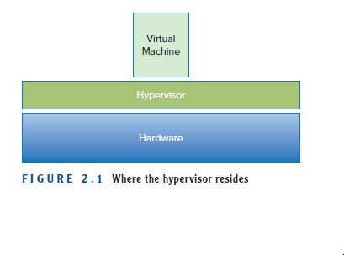
Understanding Hypervisors
What is Hypervisor?
The hypervisor is a layer of software that resides below the virtual machines and above the hardware.
Figure 2.1 illustrates where the hypervisor resides.
Without a hypervisor, an operating system communicates directly with the hardware beneath it.

Slide 47
Understanding Hypervisors
Without a hypervisor, an operating system communicates directly with the hardware beneath it.
Without a hypervisor, more than one operating system from multiple virtual machines would want simultaneous control of the hardware, which would result in chaos.
The hypervisor manages the interactions between each virtual machine and the hardware that the guests all share.

Slide 48
Understanding Hypervisors
Types of Hypervisors
There are two classes of hypervisors, and their names, Type 1 and Type 2

Slide 49
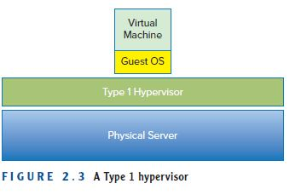
Understanding Hypervisors
Type 1 Hypervisor
Type 1 hypervisors run directly on the server hardware without an operating system beneath it. Because there is no intervening layer between the hypervisor and the physical hardware, this is also referred to as a bare-metal implementation.

Slide 50
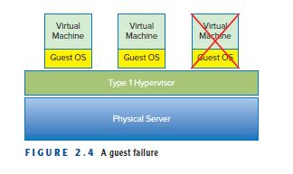
Understanding Hypervisors
Type 1 Hypervisor
Type 1 hypervisors are also considered to be more secure than Type 2 hypervisors.
Guest operations are handed off and, as such, a guest cannot affect the hypervisor on which it is supported.
A virtual machine can damage only itself, causing a single guest crash, but that event does not escape the boundaries of the VM container.
Other guests continue processing, and the hypervisor is unaffected as well.
From a pure financial standpoint, a Type 1 hypervisor would not require the cost of a host operating system, although from a practical standpoint, the discussion would be much more complex and involve all of the components and facets that comprise a total cost of ownership calculation.

Slide 51
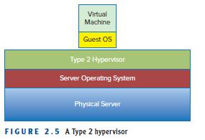
Understanding Hypervisors
Type 2 Hypervisor
A Type 2 hypervisor itself is an application that runs atop a traditional operating system
One benefit of this model is that it can support a large range of hardware because that is inherited from the operating system it uses.
Often Type 2 hypervisors are easy to install and deploy because much of the hardware configuration work, such as networking and storage, has already been covered by the operating system.

Slide 52
Understanding Hypervisors
Type 2 Hypervisor
Type 2 hypervisors are not as efficient as Type 1 hypervisors because of this extra layer between the hypervisor itself and the hardware
Every time a virtual machine performs a disk read, a network operation, or any other hardware interaction, it hands that request off to the hypervisor, just as in a Type 1 hypervisor environment.
Unlike that environment, the Type 2 hypervisor must then itself hand off the request to the operating system, which handles the I/O requests. The operating system passes the information back to the hypervisor and then back to the guest, adding two additional steps, time, and processing overhead, to every transaction.

Slide 53
Understanding Hypervisors
Type 2 Hypervisor
Type 2 hypervisors are also less reliable because there are more points of failure: anything that affects the availability of the underlying operating system also can impact the hypervisor and the guests it supports.
For example, standard operating system patches that require a system reboot would also force reboots of all the virtual machines on that host.

Slide 54
Understanding role of Hypervisors
The three characteristics defined by Popek and Goldberg illustrate these tasks:
Provide an environment identical to the physical environment
Provide that environment with minimal performance cost
Retain complete control of the system resources

Slide 55
Understanding role of Hypervisors
Resource Allocation
In a way, a hypervisor has become an operating system of sorts for the hardware, but instead of dealing with application/program requests, the hypervisor services entire (virtual) servers.

Slide 56
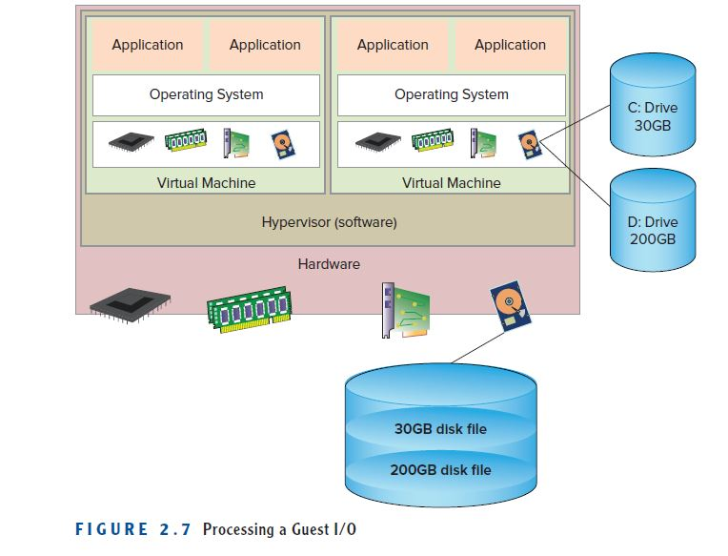
Understanding role of Hypervisors
Figure 2.7 shows how an I/O operation is processed.
Notes:
The guest operating system makes a read
to the disk that it sees. Here, the hypervisor steps in and traps that call and
translates it into a real-world physical equivalent and passes it to the storage
subsystem. When the response returns, the hypervisor passes the data back
to the guest operating system, which receives it as if it came directly from the
physical device.

Slide 57
Understanding role of Hypervisors
Resource Allocation
A guest application calls for a disk read and passes that request to the guest operating system.
The guest operating system makes a read to the disk that it sees.
Here, the hypervisor steps in and traps that call and translates it into a real-world physical equivalent and passes it to the storage subsystem.
When the response returns, the hypervisor passes the data back to the guest operating system, which receives it as if it came directly from the physical device.

Slide 58
Comparing Today’s Hypervisors
In the early days of the personal computer, there were many choices of operating system; today, there are many solutions available to choose from for a virtualization strategy.
Example Hypervisors
There are many different hypervisor vendors available. Most provide trial periods to test out their services before you buy them.

Slide 59
Comparing Today’s Hypervisors
Example Hypervisors
1.VMware vSphere with ESX/ESXi
Found in 1998 which is Type 1 hypervisor
VMware is an industry-leading virtualization technology vendor, and many large data centers run on their products.
It may not be the most cost-effective solution for smaller IT environments.
If you do not need all the advanced features VMware vSphere offers, there is a free version of this hypervisor and multiple commercial editions.
Two years after that, in 2001, both ESX 1.0 and GSX 1.0 were released. ESX was a Type 1 hypervisor and GSX was a Type 2 hypervisor.
Notes:
VMware is an industry-leading virtualization technology vendor, and many large data centers run on their products. It may not be the most cost-effective solution for smaller IT environments. If you do not need all the advanced features VMware vSphere offers, there is a free version of this hypervisor and multiple commercial editions. ESX 1.0 and GSX 1.0 elastic sky and ground storm

Slide 60
Comparing Today’s Hypervisors
Example Hypervisors
2. Citrix Xen
Is Type 1 hypervisor
The Xen hypervisor began as a research project in the late 1990s at the University of Cambridge, the goal of which was to create an
efficient platform for distributed computing.
In 2002 the code was made an open source project, allowing anyone to contribute to improving the features and capabilities.
XenSource was founded in 2004 to bring the Xen hypervisor to market, but the open source project still remained open, as it does to this day.
Two years later, Citrix Systems acquired XenSource to complement their application delivery solutions
Notes:
This Server virtualization platform by Citrix is best suited for enterprise environments, and it can handle all types of workloads and provides features for the most demanding tasks.

Slide 61
Comparing Today’s Hypervisors
Example Hypervisors
3.Microsoft Hyper-V
Microsoft Hyper-V was released in 2008 as an installable part of the Windows Server 2008 Operating System.
Hyper-V is a Type 1 hypervisor because the hypervisor code lives directly on the hardware.
The nomenclature is slightly different, though—rather than guests, the virtualized workloads are called partitions.
Notes:
Despite VMware’s hypervisor being higher on the ladder with its numerous advanced features, Microsoft’s Hyper-V has become a worthy opponent. Microsoft also offers a free edition of their hypervisor, but if you want a GUI and additional functionalities, you will have to go for one of the commercial versions. Hyper-V may not offer as many features as VMware vSphere package, but you still get live migration, replication of virtual machines, dynamic memory, and many other features.

Slide 62
Understanding Virtual Machines
Virtual machines are the fundamental components of virtualization.
They are the containers for traditional operating systems and applications that run on top of a hypervisor on a physical server.
Inside a virtual machine, things seem very much like the inside of a physical server—but outside, things are very different.
a VM is in actuality nothing more than a set of files that describes and comprises the virtual server

Slide 63
Understanding Virtual Machines
Describing a Virtual Machine
A virtual machine, also referred to as a VM, has many of the same characteristics as a physical server.
Like an actual server, a VM supports an operating system and is configured with a set of resources to which the applications running in the VM can request access
Notes:
Unlike a physical server (where only one operating system runs at any one time and few, usually related, applications run), many VMs can run simultaneously inside a single physical server, and these VMs can also run many different operating systems supporting many different applications.

Slide 64
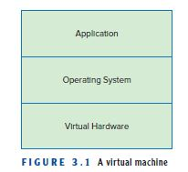
Understanding Virtual Machines
Describing a Virtual Machine
The main files that make up a VM are the configuration file and the virtual disk files.
The configuration file describes the resources that the VM can utilize: it enumerates the virtual hardware that makes up that particular VM. Figure 3.1 is a simplified illustration of a virtual machine
Notes:
A virtual machine configuration (VMC) file is an XML file that specifies the communication protocol between a master and the workers, as well as the configuration of each worker (one entry per worker) in a distributed parallel optimization application.
What is virtual machine disk file?
VMware Virtual Machine Disk (VMDK) is a format specification for virtual machine (VM) disk image files. A file with a . VMDK file extension is essentially a complete and independent virtual machine.

Slide 65
Understanding Virtual Machines
Describing a Virtual Machine
Virtual machines have access to various hardware resources, but from their point of view, they don’t know that these devices are actually virtual.
In a virtual machine, as in a physical machine, you can configure various types and amounts of peripheral devices.
But the real key to understanding virtual machines is to understand that there are two different views of a VM: one from the inside and one from outside

Slide 66
Understanding Virtual Machines
Describing a Virtual Machine
From outside the virtual machine, what you can see is the composition and configuration of the host server.
Whether it is a laptop PC running Vmware Fusion, Cisco running VMware vSphere or Citrix XenServer; the resources to which you have access are all of the systems devices.
From inside a virtual machine, the view is identical to being inside a physical machine.
If you are running Windows and open up the various Control Panel utilities to examine your system, you will find very little that would make you think twice.

Slide 67
Understanding Virtual Machines
Describing a Virtual Machine
If you are running Windows and open up the various Control Panel utilities to examine your system, you will find very little that would make you think twice.
Storage devices, C: drives, D: drives, etc. are where they should be; network connections are visible and functional; and system services are running.
There is some amount of memory in the server along with one or more CPUs, possibly a D drive, monitor, keyboard, and maybe even a floppy drive.
Everything looks just as it ought to, until you dig down and look at Windows Device Manager, as shown in Figure 3.2.

Slide 68
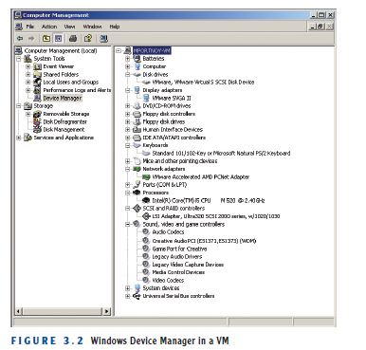
Understanding Virtual Machines
Describing a Virtual Machine

Slide 69
Understanding Virtual Machines
Describing a Virtual Machine
Here you can see where real and virtual begin to diverge. Examining the network adapter and the storage adapter also reveals an industry standard device.
The display adapter is not the same as your actual monitor. It is created as a standard device driver to be used on any monitor. The disk drives and the DVD/CD drives are also specialized virtual drivers.
What happens is that the hypervisor underneath presents the virtual machines with generic resources to which they connect

Slide 70
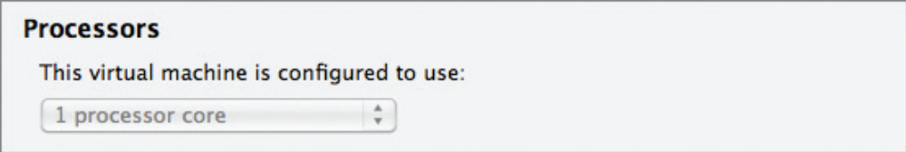
Understanding Virtual Machines
Examining CPU in VM
Virtual machines are configured to run with one or more processors
if you examine the hardware from the VM’s standpoint, you will see that only one CPU is available.
From the host’s standpoint, what has been assigned is the virtual machine’s ability to schedule CPU cycles on the host’s available CPUs
In this case, illustrated in Figure 3.3, the single CPU VM can schedule a single CPU’s worth of capacity.
F I G U R E 3 . 3 CPU settings in a VM

Slide 71
Understanding Virtual Machines
Examining CPU in VM
The host does not reserve a CPU solely for the use of a particular VM; instead, when the VM needs processing resources, the hypervisor takes the request, schedules the operations, and passes the results back to the VM through the appropriate device driver.
It is important to remember that usually the host has many more CPUs available than any one VM, and that the hypervisor is scheduling time on those processors on behalf of the VMs, rather than a VM actually having a dedicated CPU.
Notes:
.

Slide 72
Understanding Virtual Machines
Examining memory in VM
Memory, or RAM resources, is probably the simplest to understand in the virtual environment. Just as in a physical machine, having enough memory resources in a virtual machine is often the difference between success and failure when evaluating an application’s performance.
As shown in Figure 3.4, a virtual machine is allocated a specific amount of memory, and that is all that it can utilize, even though there might be orders of magnitude more memory available on the physical machine.
Notes:
A multicore processor is an integrated circuit that has two or more processor cores attached for enhanced performance and reduced power consumption. These processors also enable more efficient simultaneous processing of multiple tasks, such as with parallel processing and multithreading.

Slide 73
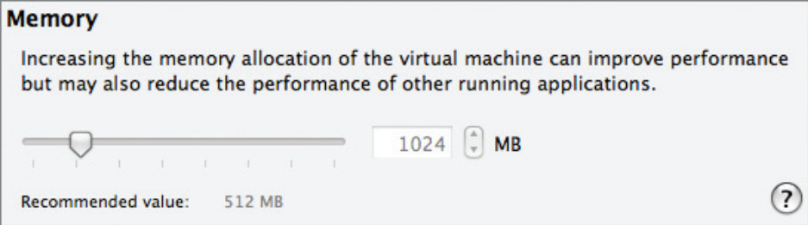
Understanding Virtual Machines
Examining memory in VM
Memory, or RAM resources, is probably the simplest to understand in the virtual environment. Just as in a physical machine, having enough memory resources in a virtual machine is often the difference between success and failure when evaluating an application’s performance.
As shown in Figure 3.4, a virtual machine is allocated a specific amount of memory, and that is all that it can utilize, even though there might be orders of magnitude more memory available on the physical machine.
Figure 3.4, Memory in virtual machine
Notes:
A multicore processor is an integrated circuit that has two or more processor cores attached for enhanced performance and reduced power consumption. These processors also enable more efficient simultaneous processing of multiple tasks, such as with parallel processing and multithreading.

Slide 74
Understanding Virtual Machines
Examining memory in VM
Unlike physical machines, when a virtual machine
requires more memory, you can merely reconfigure the amount and the VM will have access to the added capacity, sometimes without even needing a reboot
Figure 3.4, Memory in virtual machine

Slide 75
Understanding Virtual Machines
Examining Network Resources in a Virtual Machine
virtual networking provides a VM with a way to communicate with the physical world.
Each virtual machine can be configured with one or more network interface cards, or NICs, that represent a connection to a network.
These virtual NIC cards, however, don’t connect with the physical NIC cards in the host system.
The hypervisor supports the creation of a virtual network that connects the virtual NICs to a network that is composed of virtual switches

Slide 76
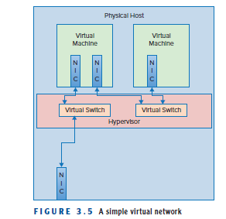
Understanding Virtual Machines
Examining Network Resources in a Virtual Machine
virtual networking provides a VM with a way to communicate with the physical world.

Slide 77
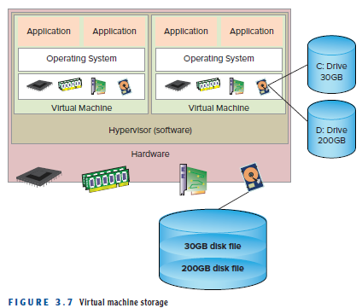
Understanding Virtual Machines
Examining Storage in a Virtual Machine
As shown in Figure 3.7, a virtual machine running Windows will see a C: drive, a D: drive, and maybe many more. In actuality, those “drives” are merely carved out regions of disk space on a shared storage device, and the hypervisor manages the presentation to the VM.

Slide 78
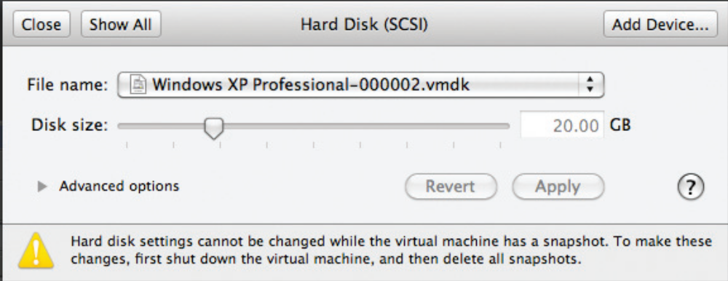
Understanding Virtual Machines
Examining Storage in a Virtual Machine
Virtual servers need storage to work with, and like the resources you’ve seen so far, what gets presented to the virtual machine and what the virtual machine believes it is seeing are very different.
Figure 3.8 illustrates the virtual machine’s view of storage resources. As a virtual machine talks to a virtual SCSI disk adapter, the hypervisor passes data blocks to and from the physical storage
F I G U R E 3 . 8 Storage resources in a VM
Notes:
Small Computer System Interface

Slide 79
Understanding Virtual Machines
Understanding How a Virtual machine Works
One way to look at how virtualization works is to say that a hypervisor allows the decoupling of traditional operating systems from the hardware.
The hypervisor becomes the transporter and regulator of resources to and from the virtual guests it supports

Slide 80
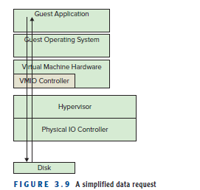
Understanding Virtual Machines
Understanding How a Virtual machine Works
Figure 3.9 will help illustrate the process of data request when a program needs some data from a file on a disk, it makes a request through a program language command, such as an fgets() in C, which gets passed through to the operating system.
Notes:
The operating system’s has file system passes the request on to the correct device manager, which then works with the physical disk I/O controller and storage device to retrieve the proper data.
The data comes back through the I/O controller and device driver where the operating system returns the data to the requesting program.

Slide 81
Understanding Virtual Machines
Understanding How a Virtual machine Works
Notes:
The operating system’s has file system passes the request on to the correct device manager, which then works with the physical disk I/O controller and storage device to retrieve the proper data.
The data comes back through the I/O controller and device driver where the operating system returns the data to the requesting program.

Slide 82
Understanding Virtual Machines
Working with Virtual Machines:I/O Request Steps for fgets() in a Virtual Machine
1. Application Request: A program running within the Guest OS calls fgets() to read input.
2. Guest OS Handling: The Guest OS processes this, treating the input device as a virtual device (e.g., a virtual keyboard).
3. Virtual Driver Intervention: A device driver in the guest OS issues the request to the virtual device.

Slide 83
Understanding Virtual Machines
Working with Virtual Machines: Illustrate the process of data request
4. Hypervisor Interception: The hypervisor intercepts the request, as the virtual device does not directly access physical hardware.
5. Host OS Mapping: The hypervisor translates the virtual request into a physical I/O command for the underlying host machine.
6. Physical Device Interaction: The host OS handles the request, reading from the actual physical device.
7. Data Return: The physical data is returned to the hypervisor, which translates it back and delivers it to the Guest OS via a virtual interrupt.
8. Application Receives Data: The Guest OS delivers the requested data to the fgets() call in the application.

Slide 84
Understanding Virtual Machines
Working with Virtual Machines
Virtual machines exist as two physical entities: the files that make up the configuration of the virtual machines and the instantiation in memory that makes up a running VM once it has been started
What are VM clones? VM Templates? VM Snapshots?

Slide 85
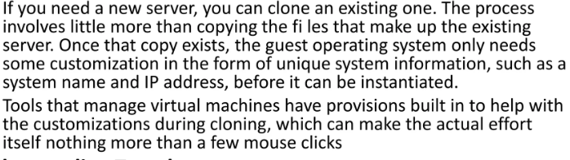
Understanding Virtual Machines
Working with Virtual Machines
What are VM clones?

Slide 86
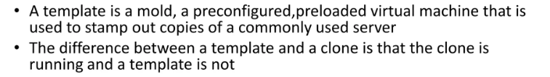
Understanding Virtual Machines
Working with Virtual Machines
What are VM Templates?
Notes:
A template is a master copy of a virtual machine that can be used to create many clones

Slide 87
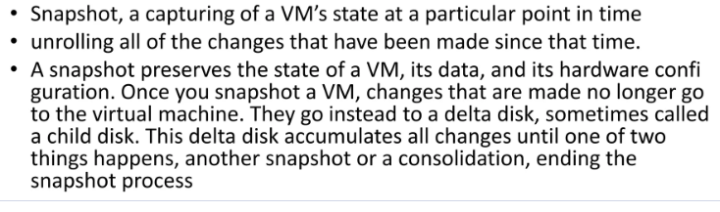
Understanding Virtual Machines
Working with Virtual Machines
What are VM Snapshots?
Snapshots provide a change log for the virtual disk and are used to restore a VM to a particular point in time when a failure or system error occurs.

Slide 88
Understanding Virtual Machines
Working with Virtual Machines
What are OVFs:? Another way to package and distribute virtual machines is using the Open Virtualization Format (OVF).
OVF is a standard, created by an industry-wide group of people representing key vendors in the various areas of virtualization.
The purpose of the standard is to create a platform and vendor-neutral format to bundle up virtual machines into one or more fi les that can be easily transported from one virtualization platform to another.
Most virtualization vendors have options to export virtual machines out to OVF format, as well as have the ability to import OVF formatted VMs into their own formats.

Slide 89
Feature | Clone | Template | Snapshot | OVF/OVA
Purpose | Create a new copy | Mass deployment | Point-in-time rollback | Portability/Export
Independence | Fully independent | Dependent on parent | Dependent on parent | Portable Package
Power On | Yes | No (must clone first) | Yes (when created) | No (must import)
Storage Need | High (full copy) | Low (shared disk) | Varies (increases over time) | Varies (compressed)
Lifespan | Long-term | Long-term | Short-term (Temporary) | Long-term

